Slide 1
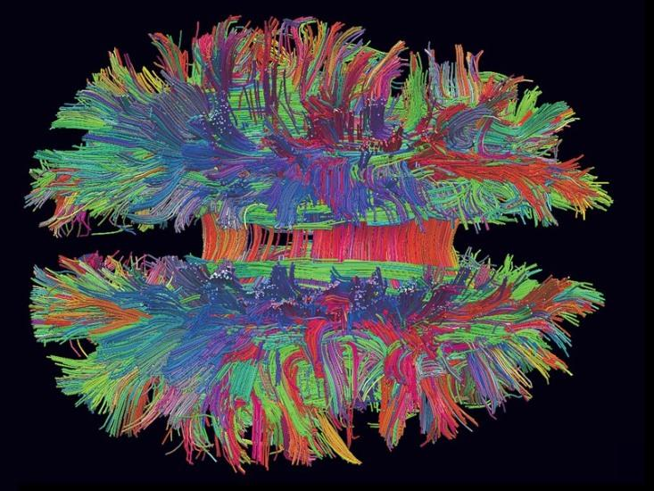
The Neuroscience of Emotions Part 3
Sangeeta Das Bhattacharya MD,MPH
School of Medical Science and Technology IIT Kharagpur

Slide 2
Neuroscience of Emotion Part 3
2 Big Ideas
Social Reality
Collective Intentionality

Slide 3
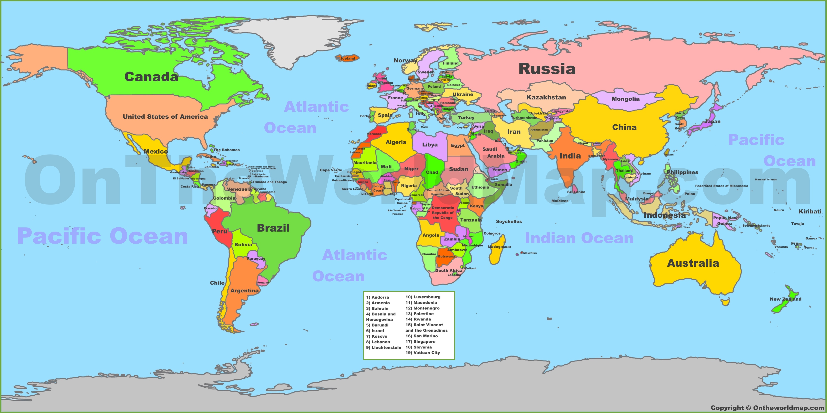
Two Big Ideas
Social Reality
Creations of not individual minds but collections of human minds

Slide 4

Two Big Ideas
Collective Intentionality
Shared knowledge
Power of minds to be jointly directed at objects, matters of fact, states of affairs, goals, or values.

Slide 5
Activity
In groups
Discuss how many different languages you represent as a group
Come up with a word for to describe an emotion concept
Present it to the whole class

